Slide 1
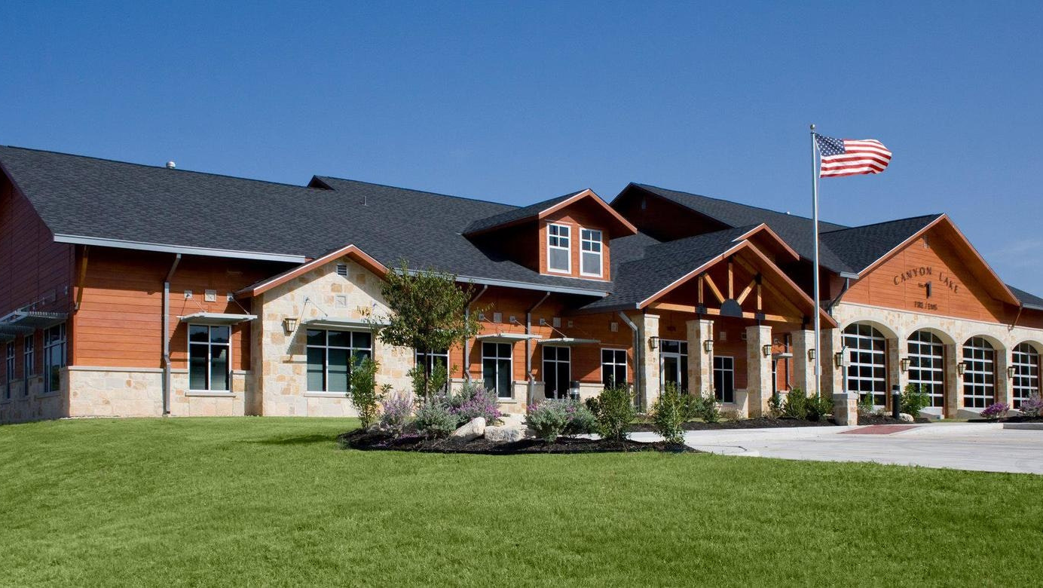

CANYON LAKE
FIRE/EMS
ANNUAL REPORT
2025
COMAL COUNTY
ESD NO. 2 & NO. 3

Slide 2
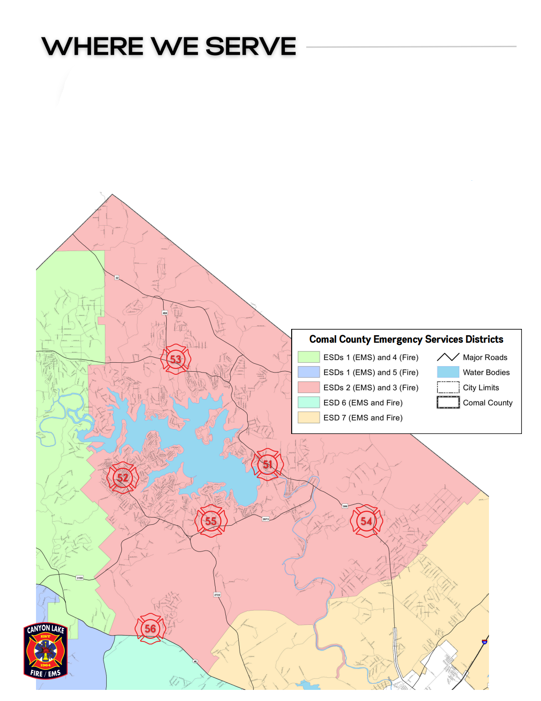
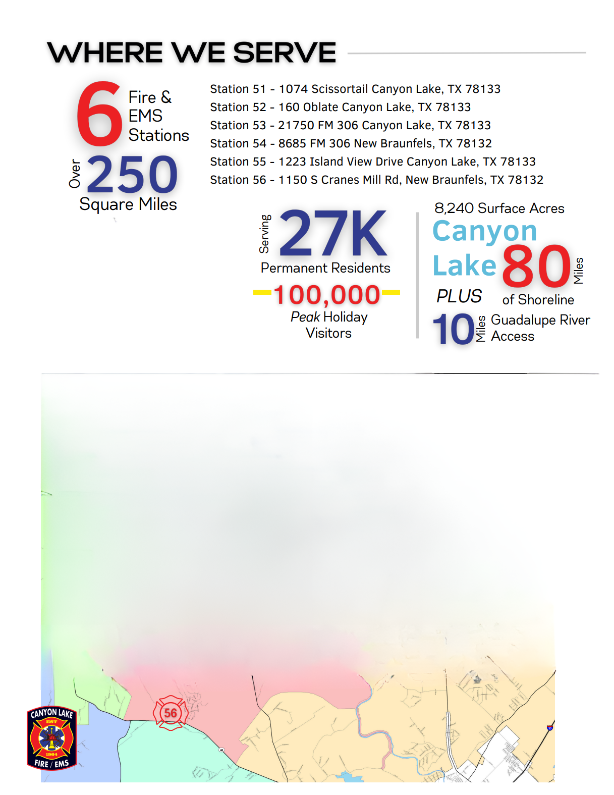

6
Fire &
EMS
Stations
WHERE WE SERVE
250
Square
Miles
30K

Slide 3

COMAL COUNTY EMERGENCY SERVICES DISTRICTS NO. 2 & NO. 3
2025
COMMISSIONERS
ESD NO. 2
Comal County ESDs No. 2 & No. 3 have identical geographic boundaries.
Bob Janusaitis, President
Francesca Hays, Vice-President
Chelsea Ormond, Secretary
Tom Crossan, Treasurer
Jeremy Czapinski, Asst. Treasurer
ESDs No. 2 & No. 3 have a joint strategic plan to ensure the continued delivery of high-quality Fire/EMS services to the Canyon Lake community.
ESD No. 3 is the authority having jurisdiction and directly providing fire services, employment of personnel, ownership and maintenance of all real-property.
ESD No. 2 is the authority having jurisdiction for Emergency Medical Services, ownership of all ambulances, and contracts for the provision of these services with ESD No. 3.
ESD NO. 3
Stuart Magloff, President
Holly Gill, Vice-President
Susan Shirley-Menzel, Secretary
Don Wagner, Treasurer
Alan Stahlman, Asst. Treasurer
In November 2024, ESD No. 2 & No. 3 agreed to their fourth 5-year Interlocal Agreement through the end of 2029.
ESDs No. 2 & No. 3 renewed an Interlocal Agreement with
ESD No. 6 to provide initial Fire/EMS response to a portion of their district providing faster response time to residents from Station 56.

Slide 4
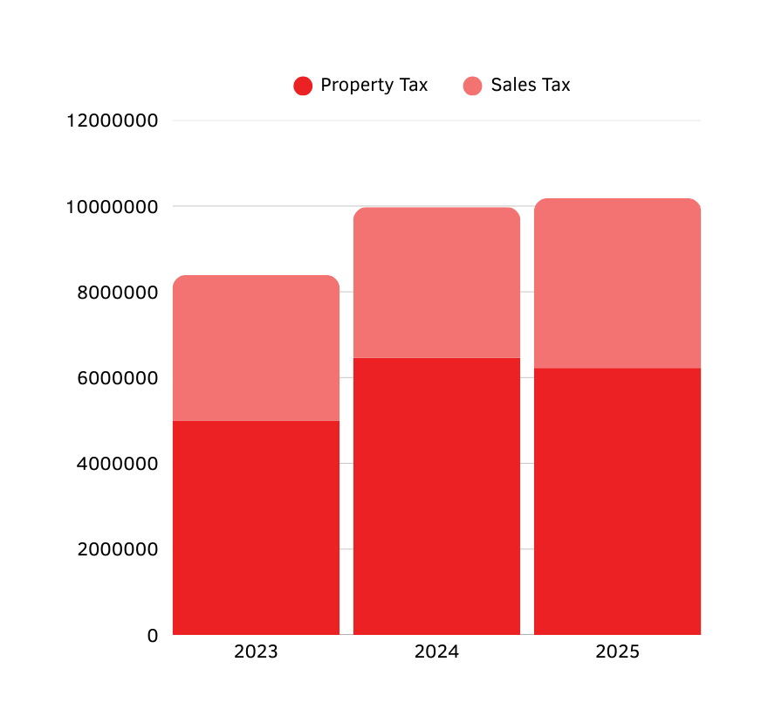



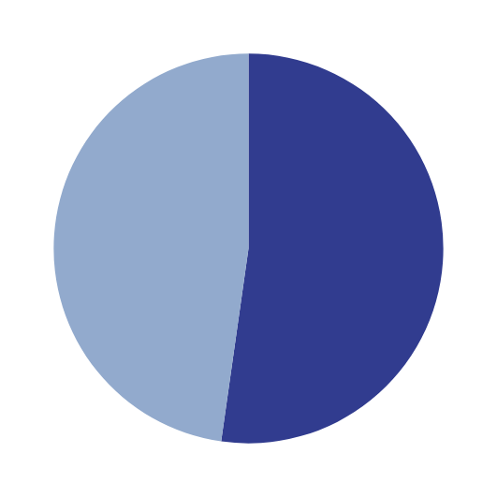




ESD NO. 3 FINANCIAL PERFORMANCE
(UNAUDITED FY 25)
Tax Rate Comparison
$0.0625
2023
$9,974,986
$10,182,897
$0.065178
2024
$16,419,280
$8,390,971
$3.51M
$3.95M
$0.063791
2025
$17,959,847
$3.39M
Debt Service
$6.46M
Station 54/56 $355,838
Station 52/Admin $472,523
$828,361 Paid in 2025
$6.22M
*Revenue includes Ad Valorem, Sales Tax and Interlocal Agreement funding from ESDs No. 2 & 6.
$4.99M
$3.72M
$5.58M
At the end of 2025, the ESD No. 3 Reserve/Emergency Fund reached a total of $12.2M achieving a 12-month reserve operating budget and funding for the 2 Capital Projects.
Total Paid YE 25
Balance Due
ESD No. 3 Collects a 1% Sales Tax Rate
$0
$9,352,445

Slide 5
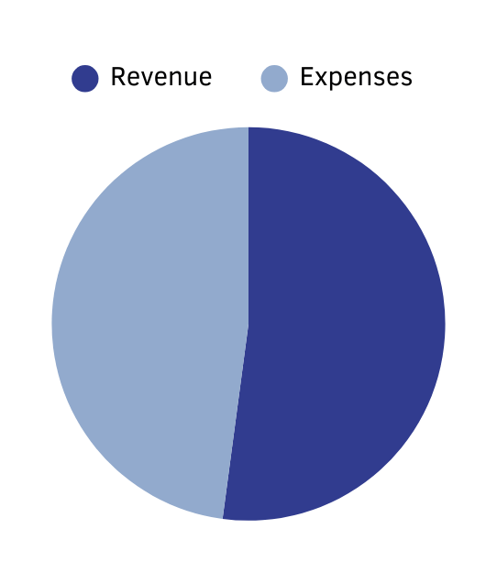
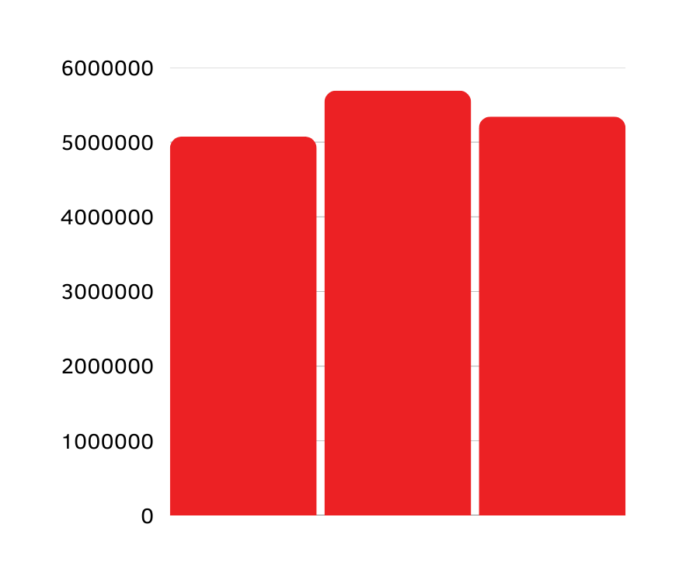




ESD NO. 2 FINANCIAL PERFORMANCE
(UNAUDITED FY 25)
Tax Rate Comparison
$0.061626
2023
$5,690,786
$5,484,561
$5,074,627
$0.057406
2024
$7,395,817
$8,045,647
$0.056167
2025
No Debt Service
*Revenue includes Ad Valorem and Patient Receivables. Expenses includes $5.7M paid to ESD No. 3 for Interlocal Agreement.
At the end of 2025, the ESD No. 2 Reserve/Emergency Fund reached a total of $6.1M achieving a ten-month reserve operating budget.
2023
2024
2025
ESD No. 2 Does Not Collect Sales Tax

Slide 6

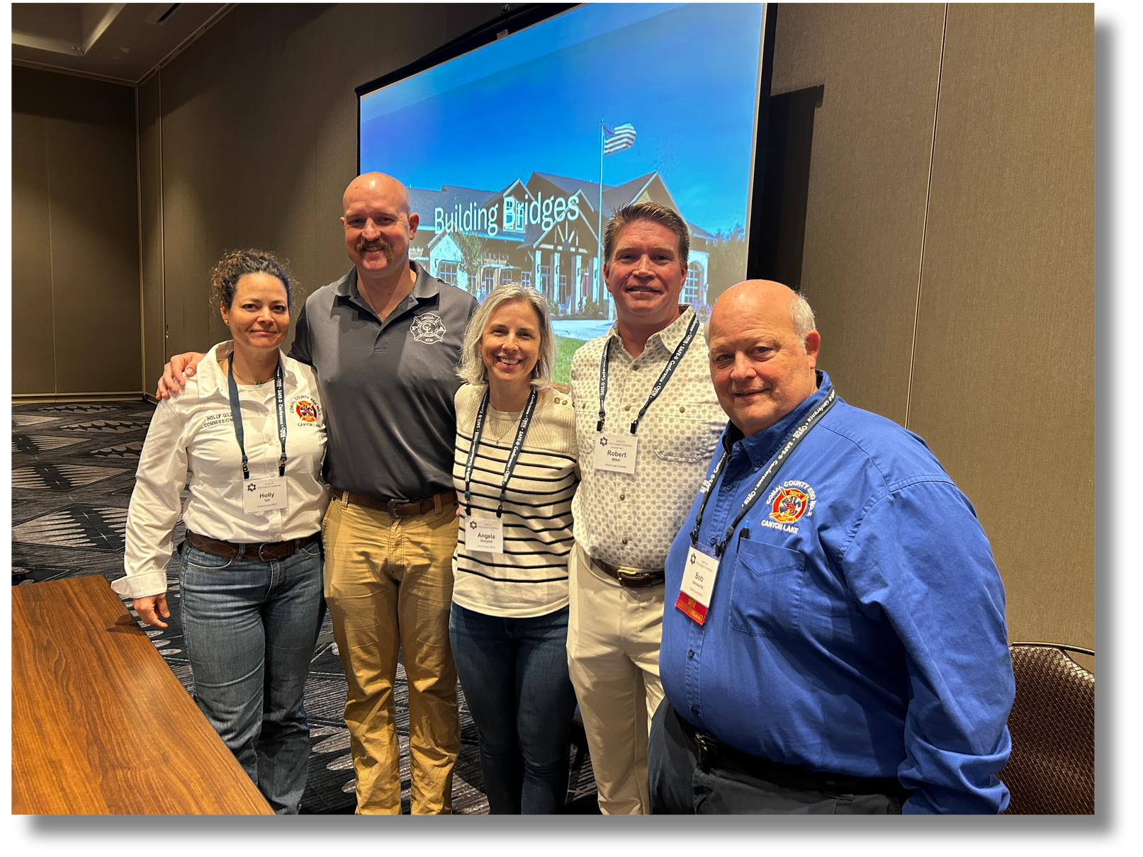
SAFE-D CONFERENCE
In February, commissioners and department leaders travelled to Round Rock for the SAFE-D annual conference. This event is open to ESD commissioners, fire chiefs, and other emergency services professionals to learn about the latest trends, best practices and legislative priorities in emergency services.
ESD No. 2 and No. 3, along with our department leaders and association president, led a presentation titled “Building Bridges” to share our collaborative partnership, successful strategies, and unique dynamic to best serve the Canyon Lake community. Approximately 50 people attended this last session of the three-day conference.

Slide 7
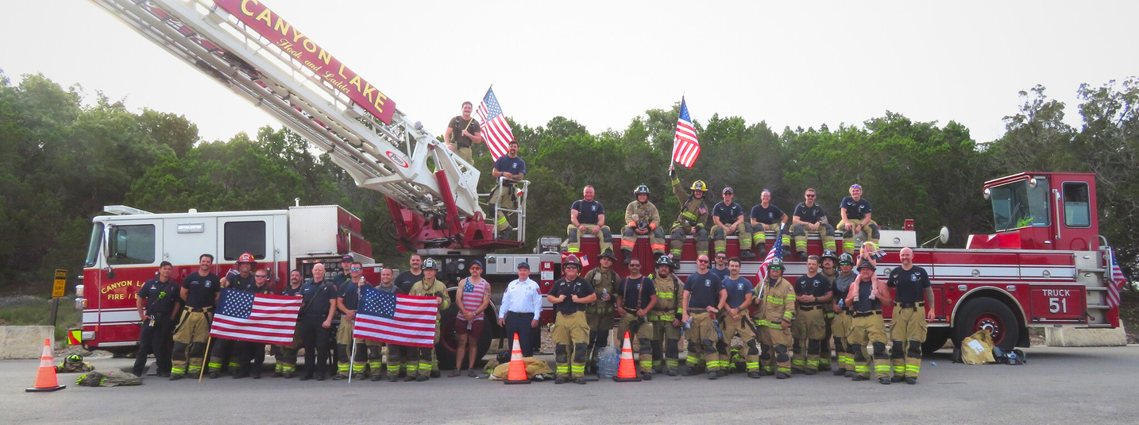

OUR TEAM
District Fleet | District Fleet
9 | Ambulances (6 Frontline, 3 Reserves)
7 | Engines (5 Frontline, 2 Reserves)
4 | Support Apparatus
2 | Tenders
1 | Aerial Ladder Truck
1 | Type 3 Engine - TIFMAS (Texas Intrastate Fire Mutual Aid System)
1 | Fire/Rescue Boat
2 | Swift Water Boats
97
Total Personnel
90
7
Operations Division
Administrative Division

Slide 8
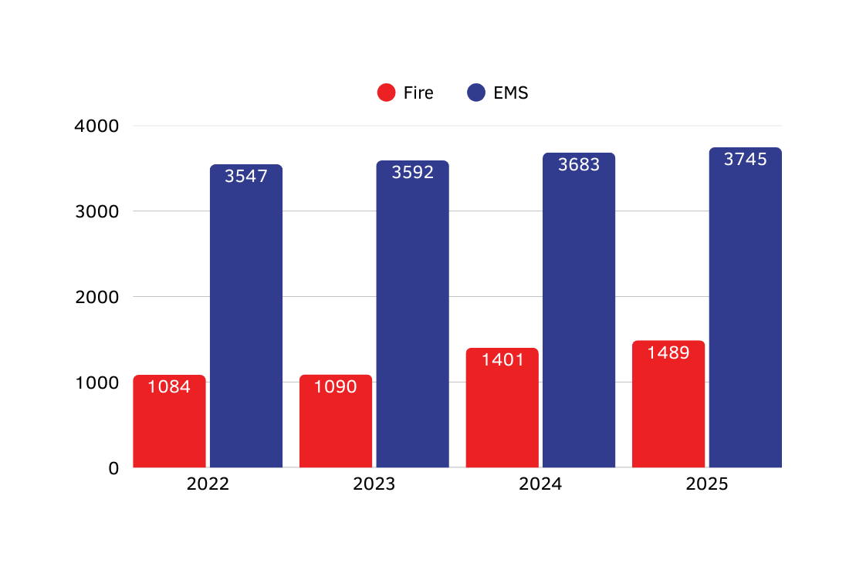
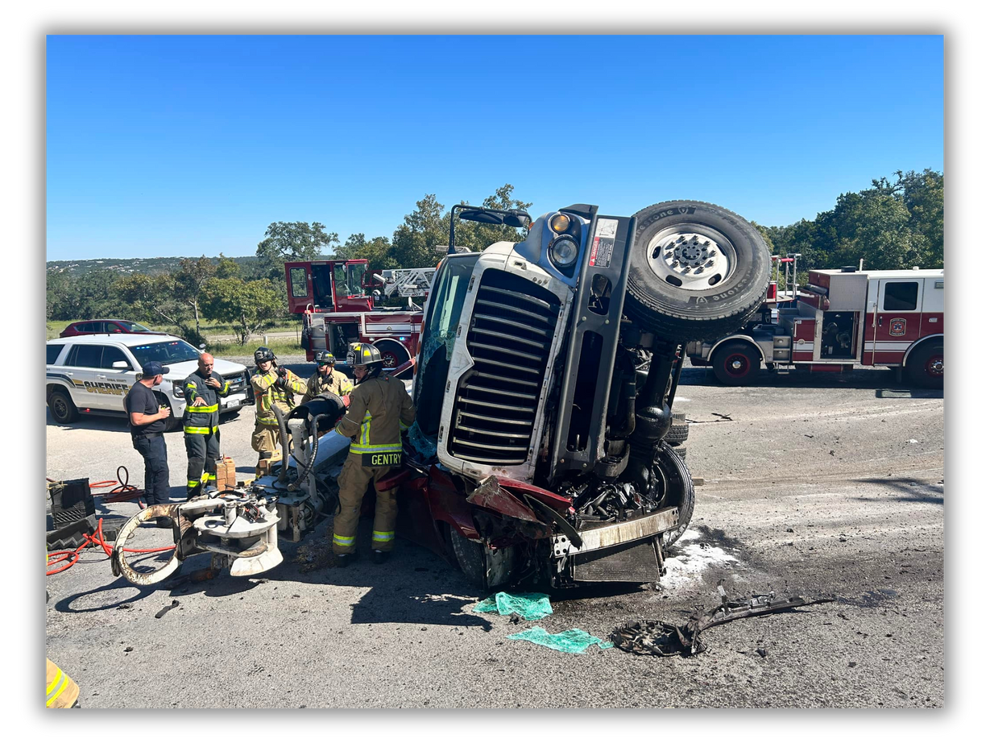

ACCOMPLISHMENTS
7
Average Response Time
:18
Minutes

Slide 9
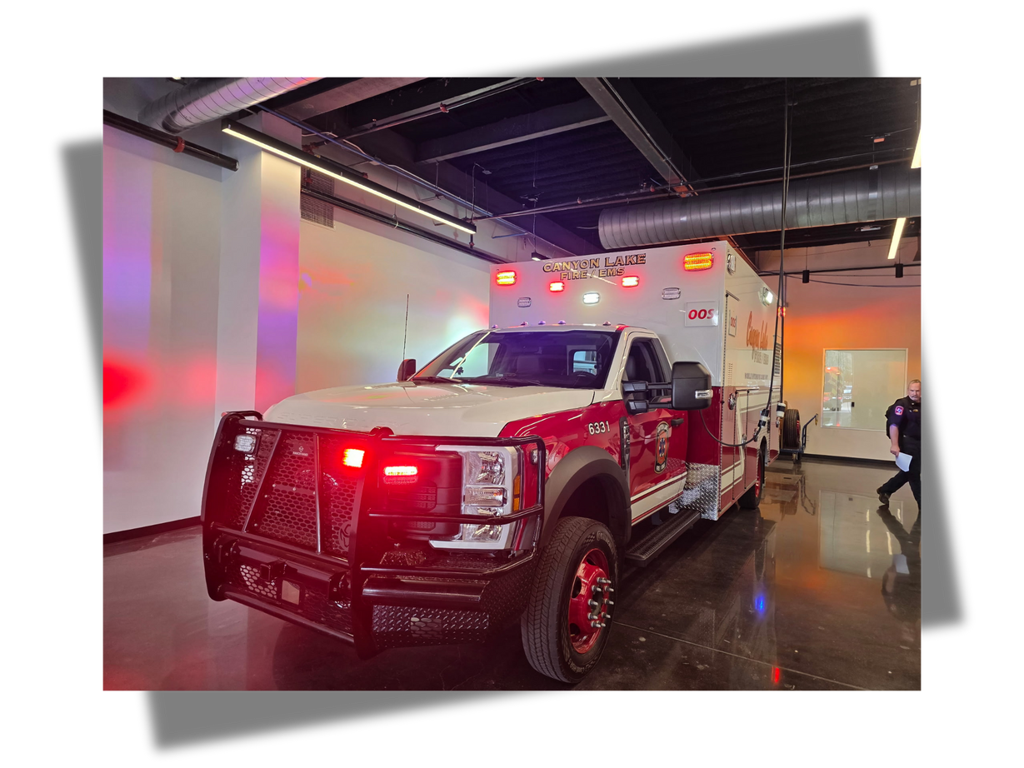
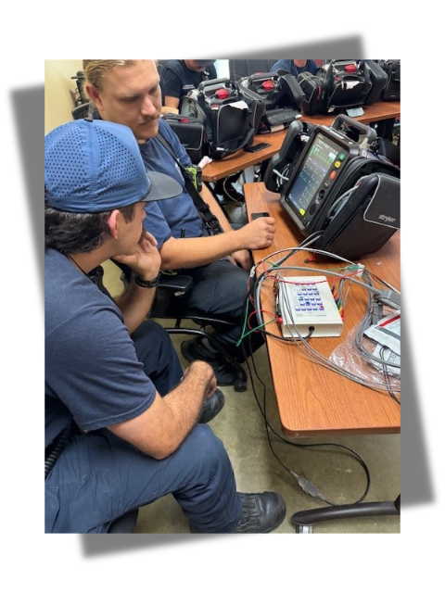
$339k
Ambulance Replacement Program
$789K
LifePak 35
New Heart Monitors

Slide 10
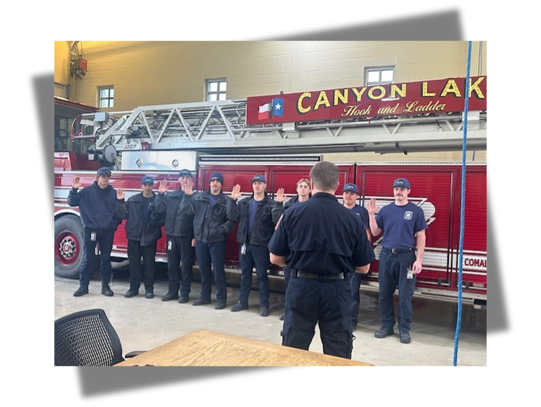
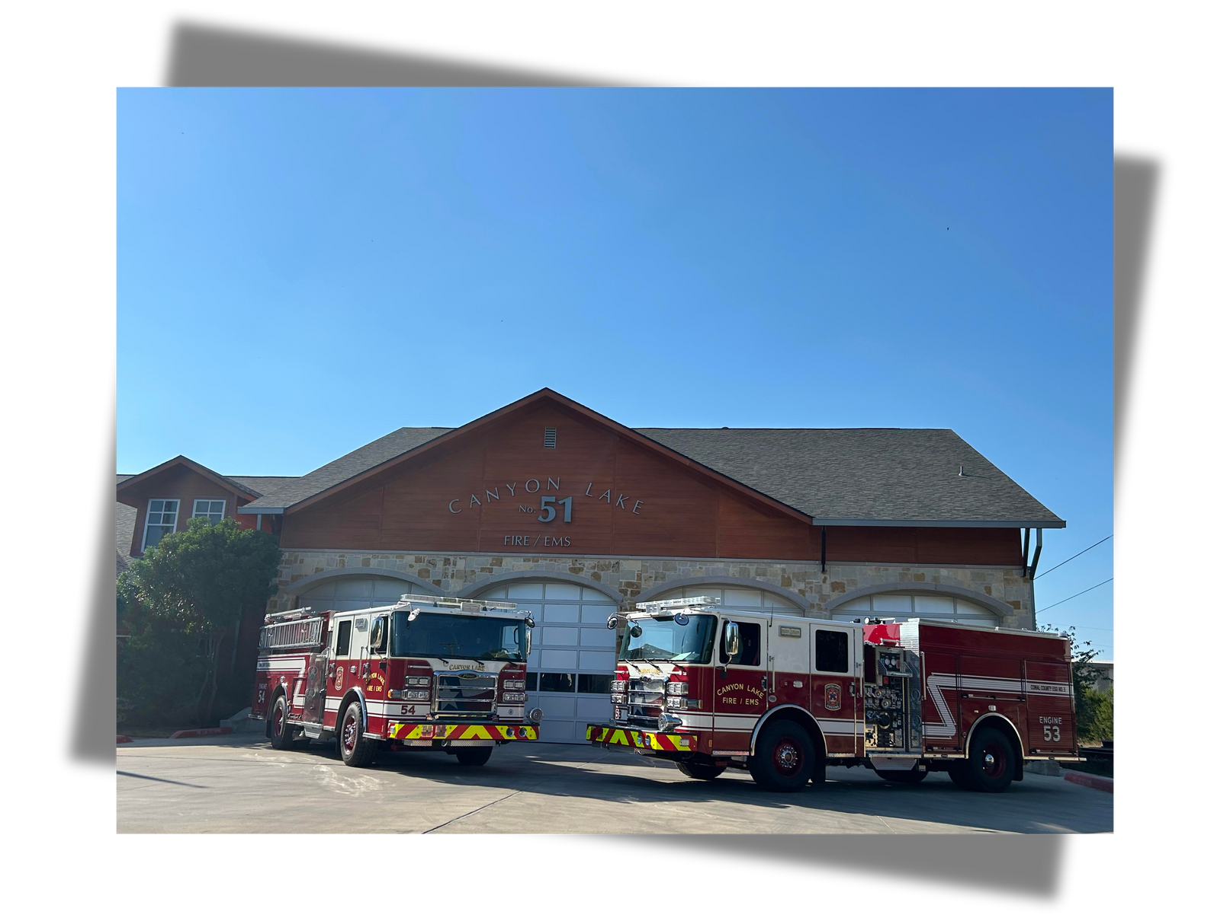
9
New Positions Added
2
New Engines Delivered
$1.66M

Slide 11
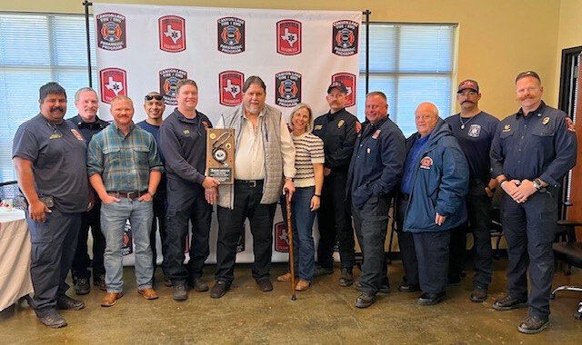
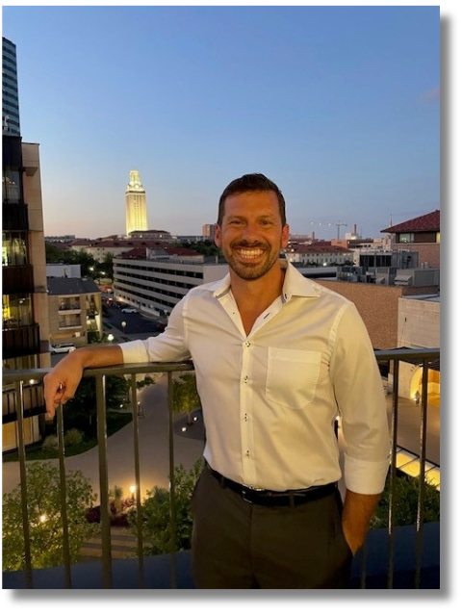
Medical Director Transition
We celebrated a significant leadership transition as we bid a grateful farewell to Dr. Flanagan, whose three decades of loyal guidance and clinical mentorship profoundly shaped our department. Following his retirement, we welcomed Dr. Wright as our new Medical Director. A 19-year Marine Corps veteran and active emergency medicine physician at Dell Seton Medical Center, Dr. Wright brings a wealth of experience and fresh perspective to the unique challenges of our community. His forward-thinking vision aligns with our mission to provide exceptional emergency services to the residents and guests of Canyon Lake.

Slide 12
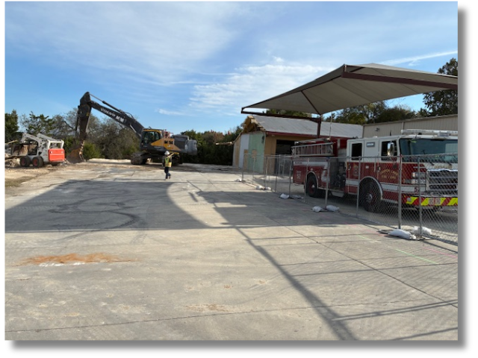
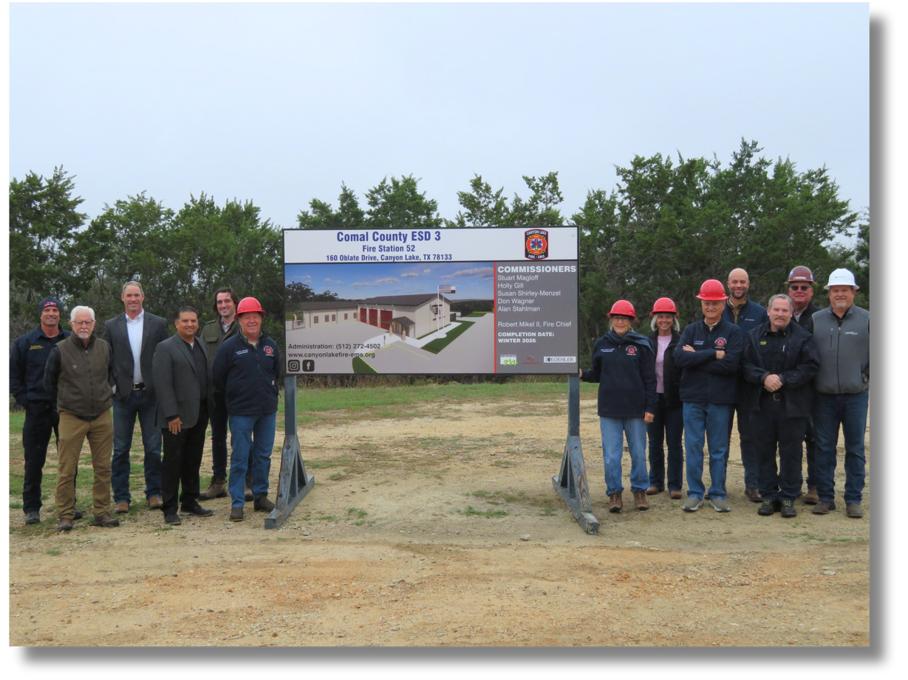

Replacement of Station 52
In alignment with our strategic Master Plan, construction is officially underway for the replacement of Startzville Fire Station 52. Originally dedicated in 1971, the facility at 160 Oblate is being modernized to better serve the evolving needs of our community and ensure the continued safety of our residents. Following an extensive site analysis, it was determined that maintaining the current location was the optimal solution for preserving satisfactory response times while maximizing operational efficiency.
This critical infrastructure investment is made possible through the continued support of our citizens and the leadership of the ESD 3 Commissioners. We are proud to collaborate with our project partners—The Koehler Company, Martinez Architects, and Rosborough Project Management—to deliver a facility that will provide high-quality emergency services for decades to come.

Slide 13

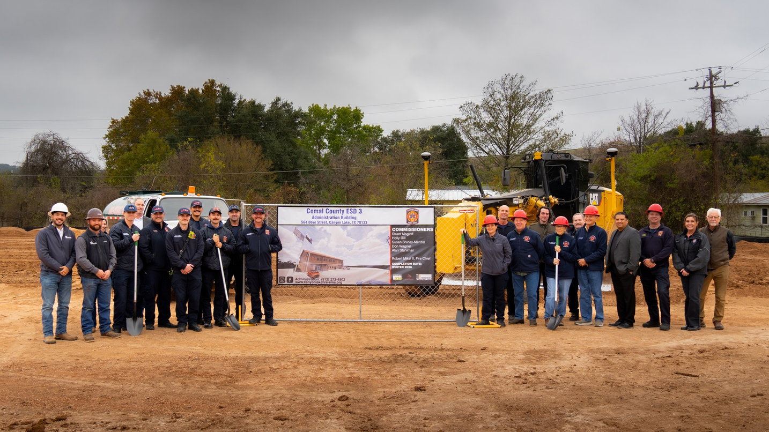
Administration and Logistics Facility
Sitework has commenced on the new Administration and Logistics Facility, a strategically developed hub designed to accommodate department growth, and financed through years of conservative financial management and stewardship of ESD No. 3 Commissioners.
This facility will centralize administrative offices, training staff, and logistics warehousing to ensure strong collaboration in emergency planning as we continue to expand. By providing our first responders with modern technology and a dedicated operational support center for leadership, we are honoring our commitment to a safer Canyon Lake. We extend our sincere gratitude to our citizens for their steadfast support and to our project partners—Frontera Construction, Martinez Architects, and Rosborough Project Management—for helping turn this long-term vision into a reality.

Slide 14
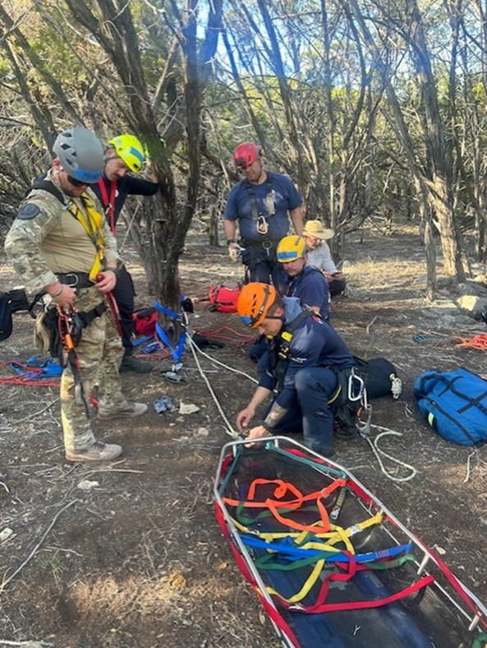
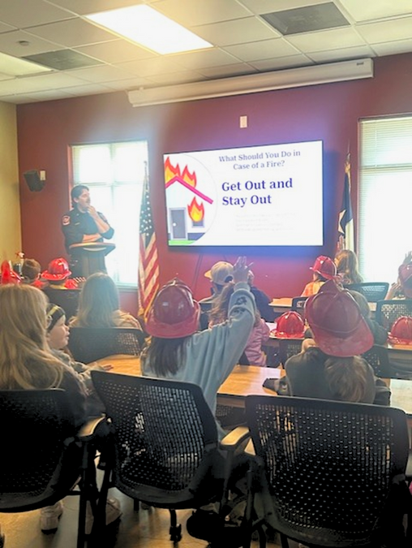
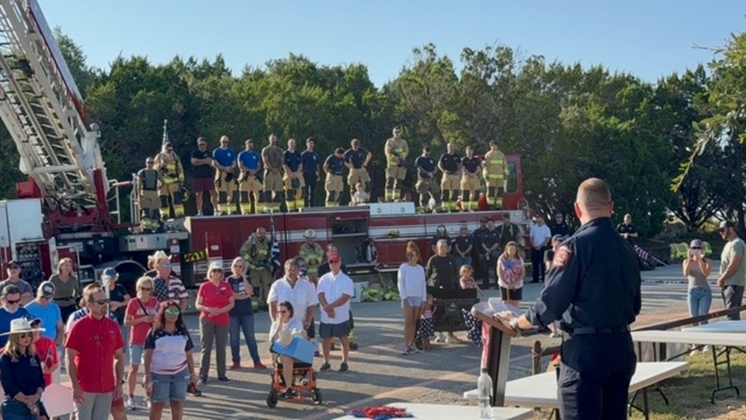
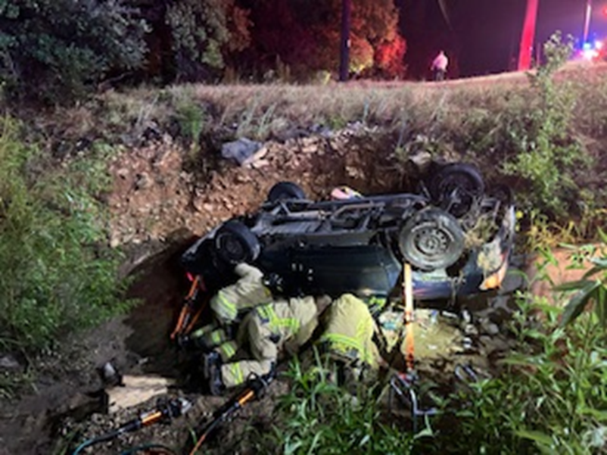
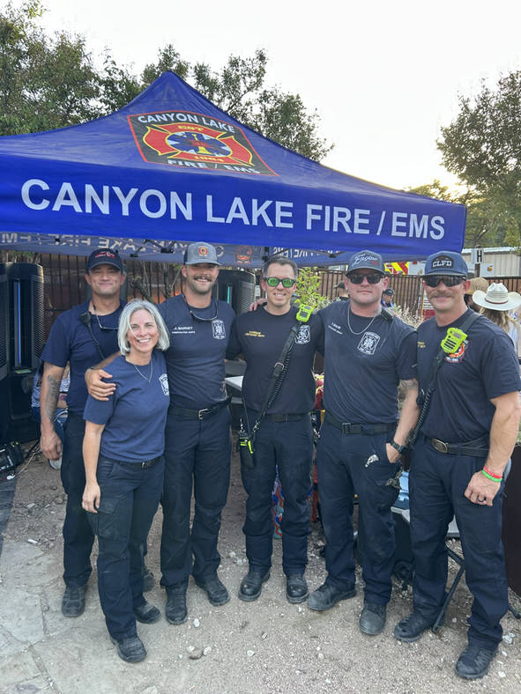
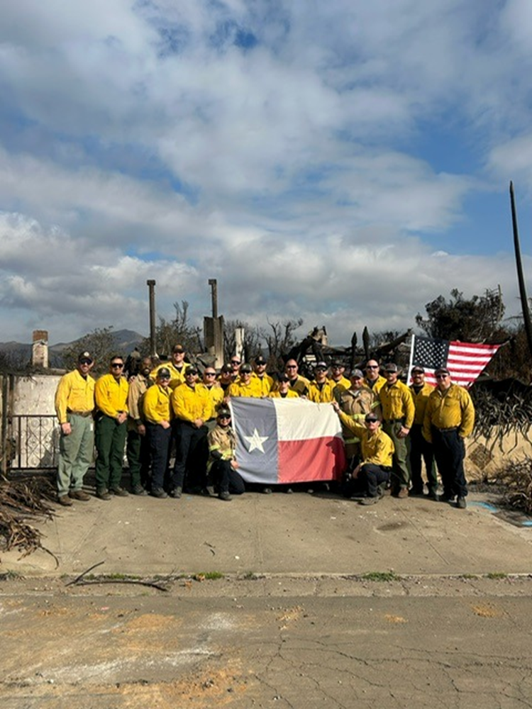

Slide 15

CONTACT US
LIKE & FOLLOW
1074 Scissortail
Canyon Lake, TX 78133
830-907-2922
facebook.com/ccesd3
Website: www.canyonlakefire-ems.org
Email Us: info@canyonlakefire-ems.org

